Slide 1
Modular Software Design
Huzaib Shafi
19-05-2020

Slide 2
Starting Notes
Should be two sessions
Shall stop if either of us gets tired
I’ve attempted to squeeze the section into 1 session
Avoided jumps to code using IDE
Detailed the basics, undetailed the later topics
Avoided a chapter on OOPs
If we complete this session, there still will be another session for some coding introduction, where we’ll detail the undetailed topics
Excuse the graphics of this presentation

Slide 3
Hotel Reservation / Management System
Maintain status of rooms
Maintain information about guests
Maintain room occupancy details
Maintain money collection information from bookings
.. and anything that you can provide .. and anything that the customer may request from time to time

Slide 4
How would you design a software for a Hotel Reservation / Management System?
A resident software that runs on a desktop (say Microsoft Windows)
A cross-platform resident desktop software (Windows/Mac/Linux)
A cloud-based software
A smartphone application (Android / iOS)
Something else?

Slide 5
How would you structure the project?
A self-sufficient single-tiered application where UI & data access code are combined into single platform (Monolithic)
A set of sub-projects, where each sub-project will be responsible for a small feature-set. A sub-project for UI, another for data access code & so on (Microservices)
Some other way?

Slide 6
Software Design
Software design is the process of envisioning and defining software solutions to one or more sets of problems.
Software design affects the behavior of a system and controls many factors in a life cycle of a software system.
Poor software design is a fundamental source of weak performance, creating difficulties in updating an application and integrating it with existing products.

Slide 7
Software Design Considerations

Slide 8
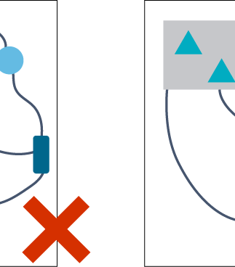
Which control flow makes more sense?

Slide 9
Monolithic vs Microservice Architectures
Monolithic: an application that runs as a single logical executable unit
Microservices: an application split into a suite of multiple smaller, independently running components or services, all complementing each other to reach a common goal and mostly communicate via REST API

Slide 10
Scaling Monolithic System

Slide 11
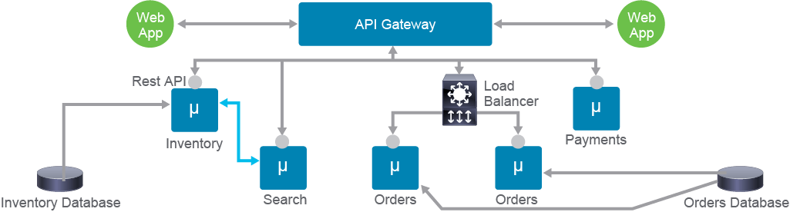
Scaling Microservices based system

Slide 12
How would you structure at coding level?
Object Oriented Programming Paradigm
Structured Programming Paradigm
Something else?

Slide 13
More questions!
How many storage units (variables/objects) will you create?
How will those storage units behave? How will they be operated upon?

Slide 15
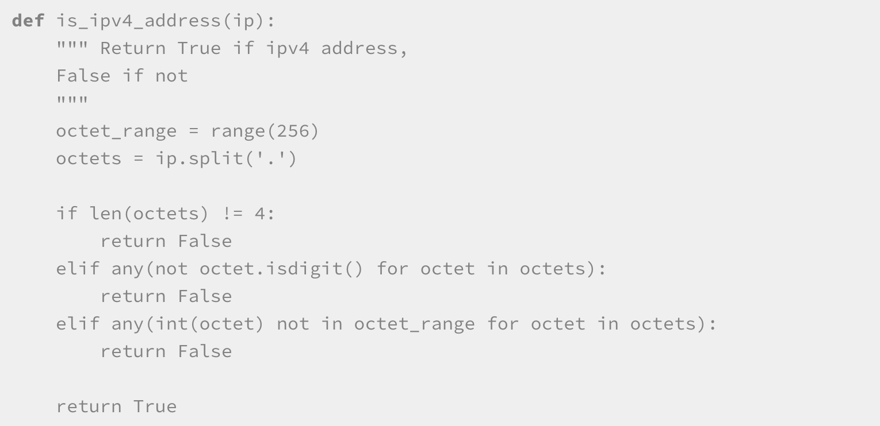
Defining a function in Python

Slide 16
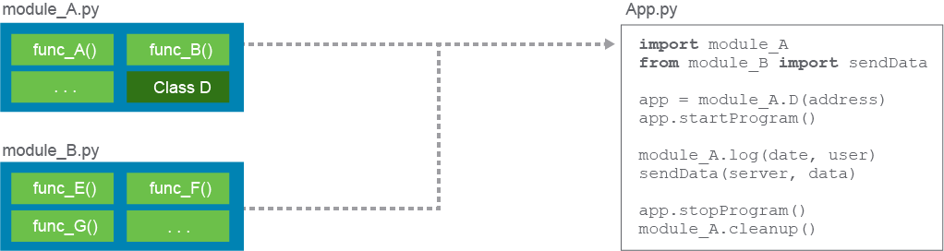
Defining & Using Modules In Python?

Slide 17
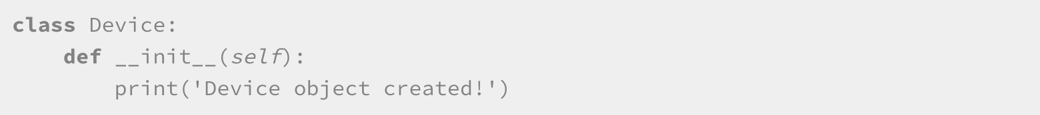
Modularity via OOP in Python
OOP is a method of programming that introduces objects.
Objects are basically records or instances of code that allow you to carry data with them and execute defined actions on them.
Class is a construct used in an object-oriented programming (OOP) language. It represents a blueprint of what an object looks like, and how it behaves.

Slide 18
Maintaining Modularity
Too many interactions between different modules can lead to confusion and unwanted side effects when something needs to be changed in a module.
Responsibility of a module needs to be transparent so that you can reasonably know what its function is.
A change in one part of the application code should not affect or break other parts of the system.
To enable independent evolvement of modules, they need to have well-defined interfaces that do not change.

Slide 19
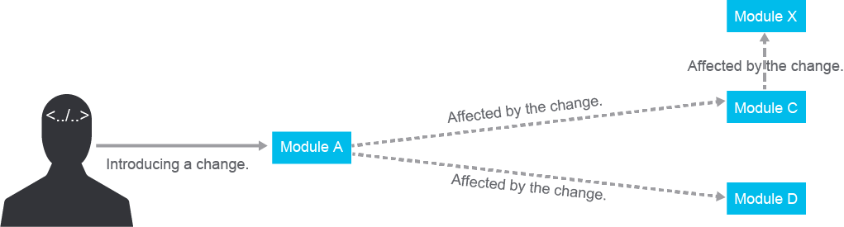
Maintaining Modularity contd.

Slide 20
Some Design Guidelines
Acyclic dependencies principle
Modules should have dependencies in one direction only.
Stable dependencies principle
Frequently changing, unstable modules can depend on modules that do not change frequently --- and should not depend on each other
Single responsibility principle
A single module should be responsible to cover some intelligible and specific technical or business feature.

Slide 21
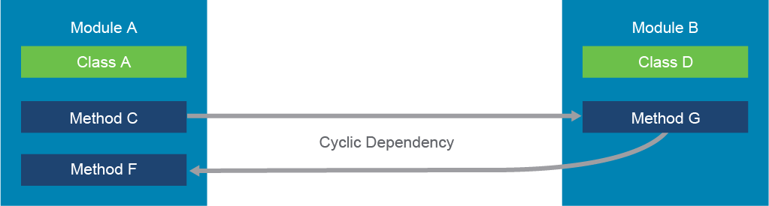
Cyclic Dependency Example

Slide 22
Dependency Inversion : Cure for Cyclic Dependency
High-level modules should not depend on low-level modules. Both should depend on abstractions.
Abstractions should not depend on details. Details should depend on abstractions.
Example in OOP > Interfaces : an abstraction that defines the skeleton code that needs to be extended in other custom classes.

Slide 23
Interfaces
An example would be having a class device that defines a show() interface.
The interface does not implement how the show() method should work.
Instead, you can create other, more low-level classes, like a Firewall class, that extends and implements the show() method.
The implementation is then specific to the low-level class.

Slide 24
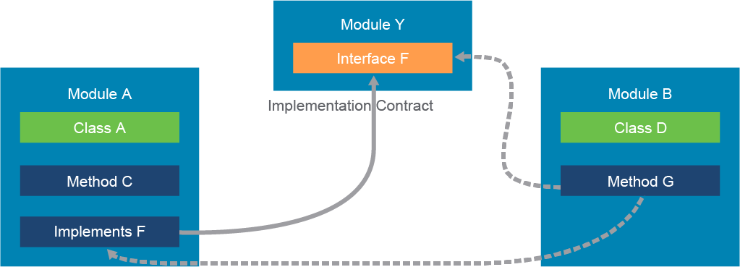

Slide 25
Coupling & Cohesion
Ideally a module should not depend on other modules: Loose Coupling
A module with multiple dependencies (over other modules) is a tightly coupled module
The purpose of a class or module should be focused on one thing and not too broad in its actions : Strong Cohesion
Modules that contain strongly related classes and functions can be considered to have strong or high cohesion.

Slide 26
Which language will you use for development?
Python
Java
C / C++
PHP
JavaScript
I don’t know. I’ll decide after clarity on the requirements.
It doesn’t matter! I can get it done in any language.

Slide 27
Need for a Unified Modeling Language
Do all the stake-holders in the project know a given programming language?
Can we represent all the high-level requirements and design in a natural language and traditional notations?
Will those terms and notations mean the same thing for everyone or is there an ambiguity possible?

Slide 28
Introducing UML

Slide 29
PaTTerns
Architectural : Architectures are composed to solve a specific problem. Some compositions happen to be more useful than others, so they become documented as architecture patterns
Design : a general, reusable solution to a commonly occurring problem within a given context in software design
Creational : Singleton, Factory
Structural : Decorator, Facade
Behavioural : Observer, State

Slide 30
Architectural Patterns
Layered or multitier architecture pattern
Event-driven architecture pattern
Microservices architecture pattern
Model-View-Controller (MVC) architecture pattern
Space-based architecture

Slide 31
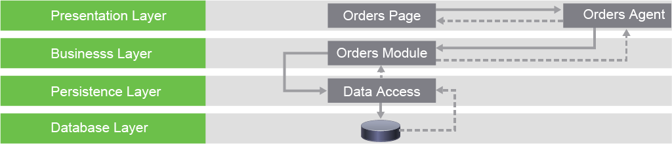
Layered or multitier architecture pattern

Slide 32
Model – View – Controller (MVC) architecture pattern

Slide 33
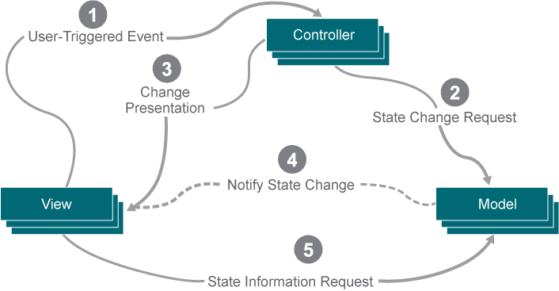

Slide 34
Implementing MVC

Slide 35
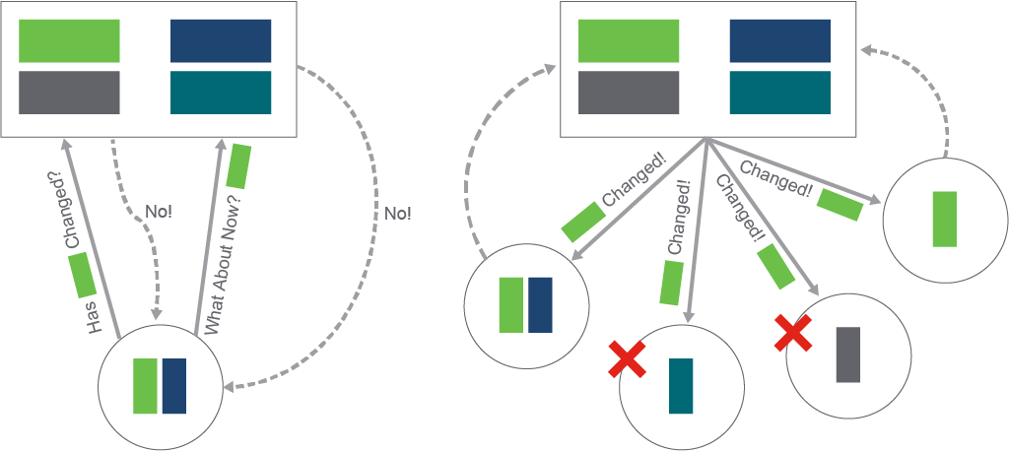
Observer Design Pattern

Slide 36
Thank You

